Slide 1
Ch.11 Pointers

Slide 2

What you will learn in this chapter
In this chapter
The basics of pointers
Learn knowledge .
What is a pointer ?
Address of variable
Declaration of a pointer
Indirect reference operator
Pointer arithmetic
Pointers and Arrays
Pointers and functions

Slide 3
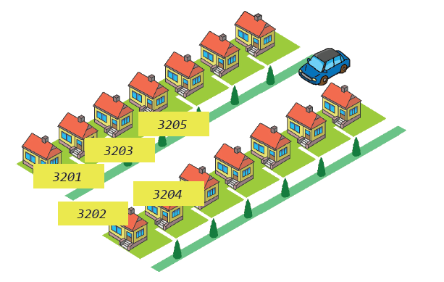
What is a pointer ?
Pointer : A variable that has an address

Slide 4
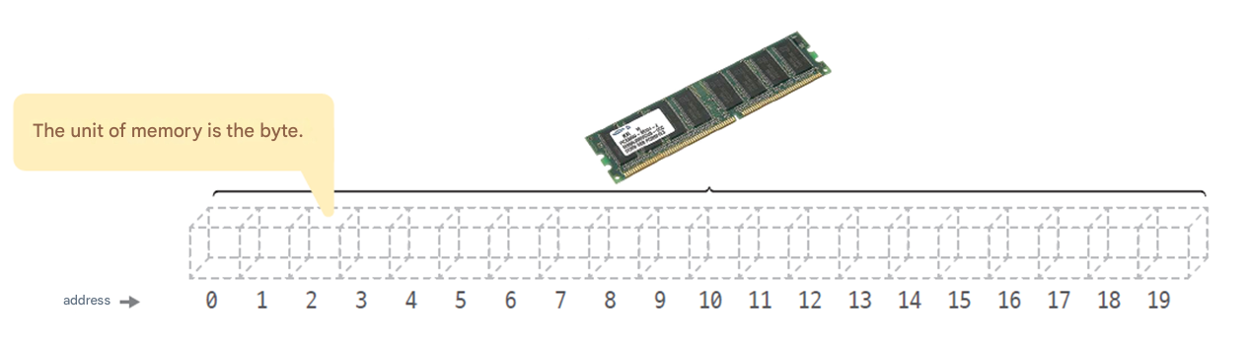
Where is it stored in the variable ?
Variables are stored in memory .
Memory is accessed in bytes.
The address of the first byte is 0, the address of the second byte is 1, …

Slide 5
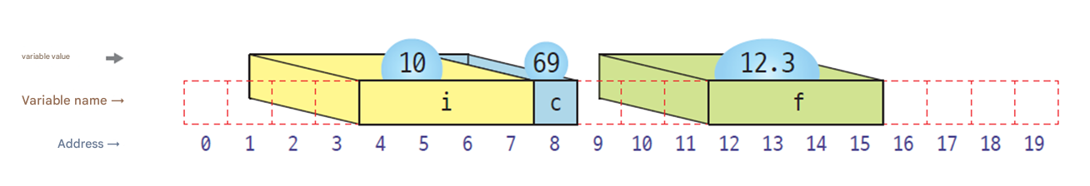
Variables and Memory
The memory space occupied varies depending on the size of the variable .
char type variable : 1 byte, int type variable : 4 bytes, …
int main( void )
{
int i = 10;
char c = 69;
float f = 12.3;
return 0;
}

Slide 6
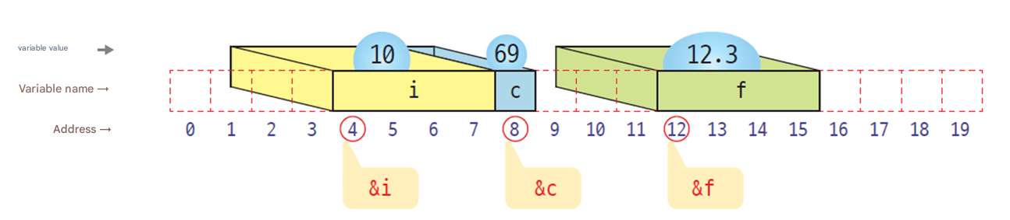
Address of variable
Operator to calculate the address of a variable : &
Address of variable i : &i

Slide 7

Address of variable
The program The address will be different each time you run it .
int main( void )
{
int i = 10;
char c = 69;
float f = 12.3;
printf ( "Address of i : %p\n" , &i ); // Print address of
printf ( "Address of c : %p\n" , &c); // Print address of
printf ( "Address of f : %p\n" , &f); // Print address of
return 0;
}
i 's address : 0000003D69DDF974
Address of c : 0000003D69DDF994
Address of f : 0000003D69DDF9B8

Slide 8
caution
Be careful when declaring multiple pointer variables on one line. Declaring them as follows is incorrect :
int *p1, p2, p3; // (×) p2 and p3 become integer variables .
To declare correctly, you must do the following :
int *p1, *p2, *p3; // (○) p2 and p3 are pointer variables of integer type.

Slide 9
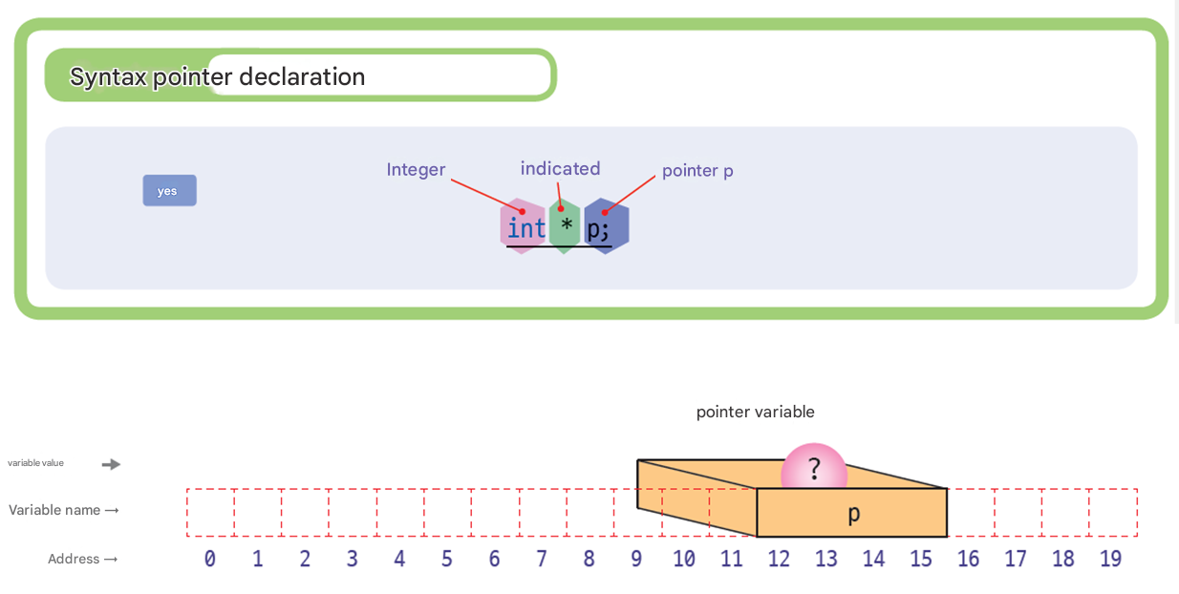
Declaration of a pointer
Pointer : A variable that holds the address of a variable.

Slide 10
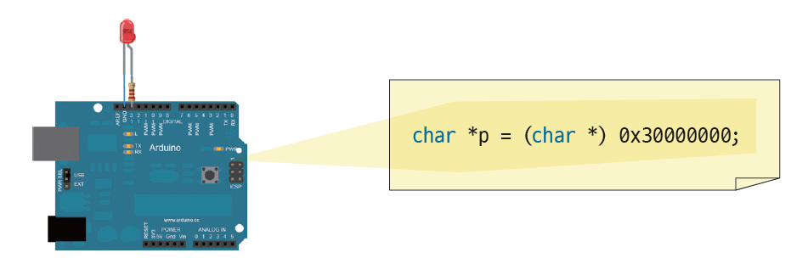
Pointer's Initialization : Initialize to absolute address
Possible on
Not working on Windows
- For security and stability, absolute address pointer initialization is not allowed. → Only addresses allocated by OS or memory addresses normally acquired through malloc, new, etc.

Slide 11
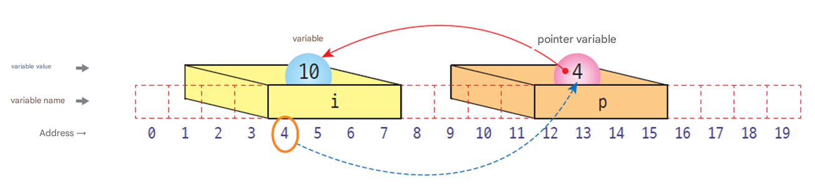
Assign the variables to pointers
int i = 10; // declare of integer variable i
int * p; // declare of pointer variable p
p = & i ; // assign the address of variable i to pointer p

Slide 12
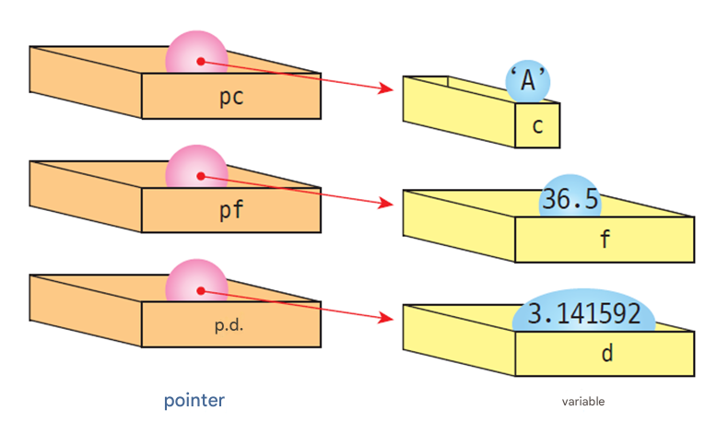
Declaration of various pointers
char c = 'A’; // character type Variable c
float f = 36.5; // Real number variable f
double d = 3.141592; // Real number Variable d
char *pc = &c; // characters indicated pointer pc
float * pf = &f; // Real number indicated Pointer pf
Double * pd = &d; // Real number indicated Pointer pd

Slide 13
Example
#include < stdio.h >
int main( void )
{
int i = 10;
double f = 12.3;
int * pi = NULL ;
double * pf = NULL ;
pi = & i ;
pf = &f;
printf( "%p % p\n" , pi, &i);
printf( "%p % p\n" , pf, &f);
return 0;
}
0000002AFF8FFB24 0000002AFF8FFB24
0000002AFF8FFB48 0000002AFF8FFB48

Slide 14
reference
NULL is stdio.h It means address 0 , a pointer constant defined as follows in the header file .
#define NULL ((void *)0)
0 is generally unusable (the CPU uses it for interrupts ). Therefore, if the value of a pointer variable is 0 , we can assume that it is not pointing to anything .
NULL pointer
Pointing to nothing

Slide 15
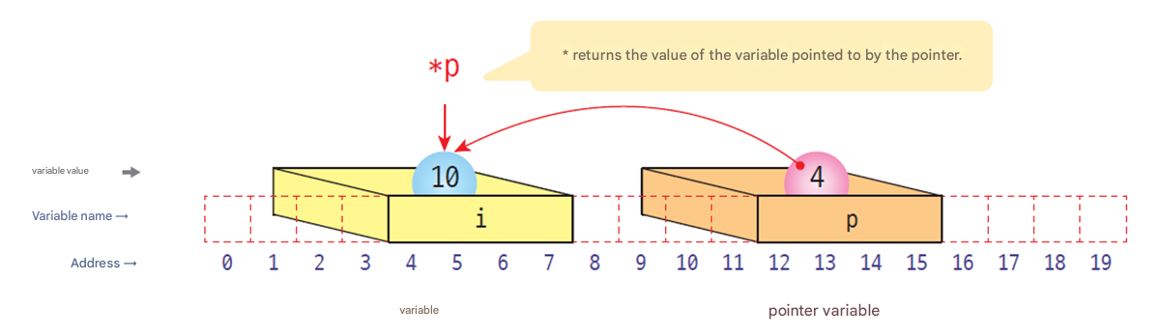
Indirect reference operator
Indirect reference operator * : Operator that retrieves the value pointed to by the pointer
int i = 10;
int * p;
p = &i ;
printf ( "%d \n" , *p);

Slide 16
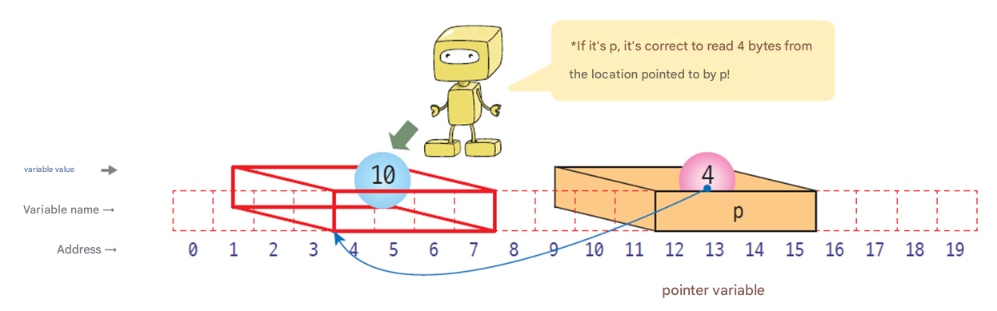
Interpretation of indirect reference operators
Indirect reference operator : Reads a value based on the type of the pointer at the specified location .
int *pi = (int *)10000;
char *pc = (char *)10000;
double *pd = (double *)10000;

Slide 17
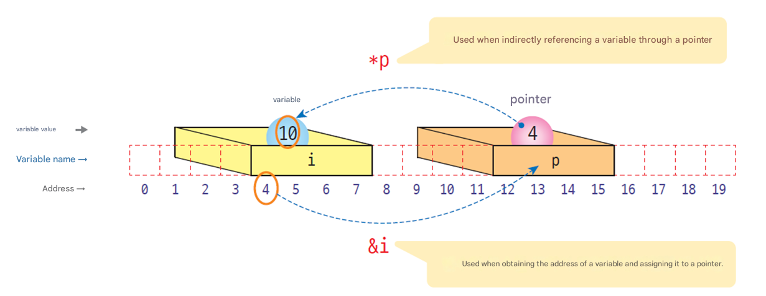
& operator and * operator
& operator : returns the address of a variable
* Operator : Returns the contents of the location pointed by the pointer .

Slide 18
Pointer Example #1
#include < stdio.h >
int main( void )
{
int i = 3000;
int *p=NULL;
p = & i ;
printf( "p = %p\n" , p);
printf( "&i = %p\n\n" , &i);
printf ( " i = %d\n" , i );
printf( "*p = %d\n" , *p);
return 0;
}
3000
p
i
p = 0000006DEA0FFBD4
& i = 0000006DEA0FFBD4
i = 3000
*p = 3000

Slide 19
Pointer Example #2
#include < stdio.h >
int main( void )
{
int x=10, y=20;
int *p;
p = &x;
printf ( "p = %p\n" , p);
printf ( "*p = %u\n\n" , *p);
p = &y;
printf ( "p = %p\n" , p);
printf ( "*p = %u\n" , *p);
return 0;
}
10
x
p
20
y
p = 0000007A8F3AF974
*p = 10
p = 0000007A8F3AF994
*p = 20

Slide 20
Pointer Example #3
#include < stdio.h >
int main( void )
{
int i =10;
int *p;
p = & i ;
printf ( " i = %d\n" , i );
*p = 20;
printf ( " i = %d\n" , i );
return 0;
}
10
i
p
Change the value of a variable through a pointer.
i = 10
i = 20

Slide 21
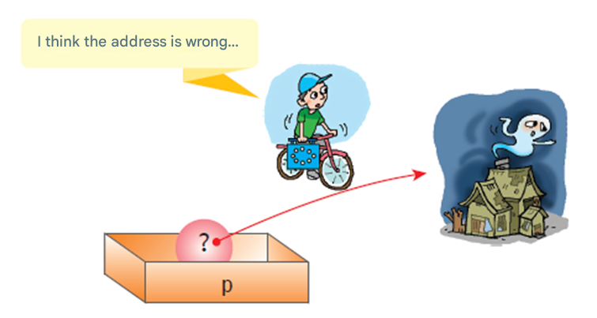
Cautions when using pointers
You should not use uninitialized pointers .
int main( void )
{
int *p; // pointer p is not initialization
*p = 100; // dangerous code
return 0;
}

Slide 22

Cautions when using pointers
Pointers are both a strength and a weakness of the C language.
Developers must use it responsibly .
When using pointers, always remember the following quote from the Spider-Man movie :

Slide 23
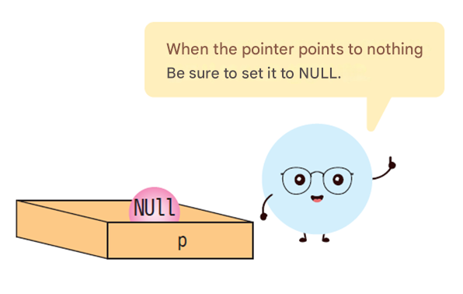
Cautions when using pointers
If the pointer points to nothing, it is initialized to NULL .
NULL pointers can be detected by hardware .
int *p = NULL;

Slide 24
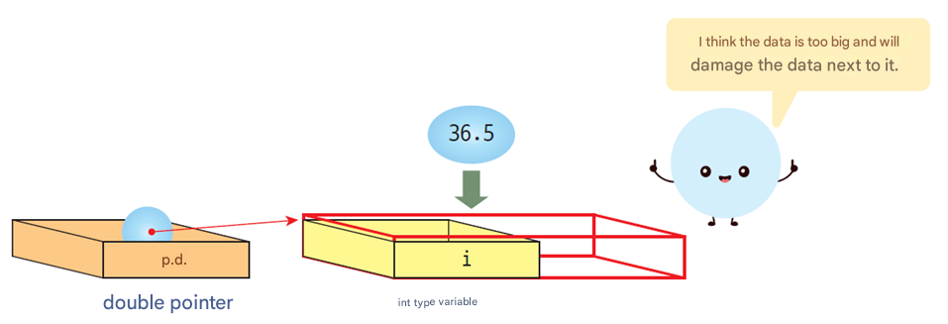
Cautions when using pointers
The type of the pointer and the type of the variable must match.
#include < stdio.h >
int main( void )
{
int i ;
double * pd ;
pd = & i ; // error !
*pd = 36.5;
return 0;
}

Slide 25
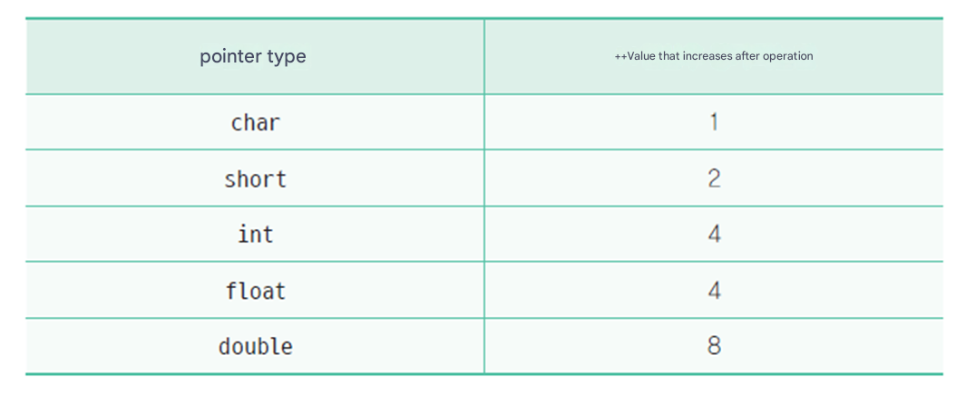
Pointer arithmetic
Possible operations : increment , decrement , addition , subtraction operations
In the case of an increment operation, the value being increased is the size of the object pointed to by the pointer.

Slide 26
Increment operation example
// Increment/decrement operation of pointer
#include < stdio.h >
int main( void )
{
char *pc;
int *pi;
double *pd;
pc = ( char *)10000;
pi = ( int *)10000;
pd = ( double *)10000;
printf( " pc=%u, pc+1=%u, pc+2= %u\n" , pc, pc + 1, pc + 2);
printf( " pi=%u, pi+1=%u, pi+2= %u\n" , pi, pi + 1, pi + 2);
printf( " pd=%u, pd+1=%u, pd+2= %u\n" , pd, pd + 1, pd + 2);
return 0;
}
pc=10000, pc+1=10001, pc+2= 10002
pi=10000, pi+1=10004, pi+2= 10008
pd=10000, pd+1=10008, pd+2=10016

Slide 27
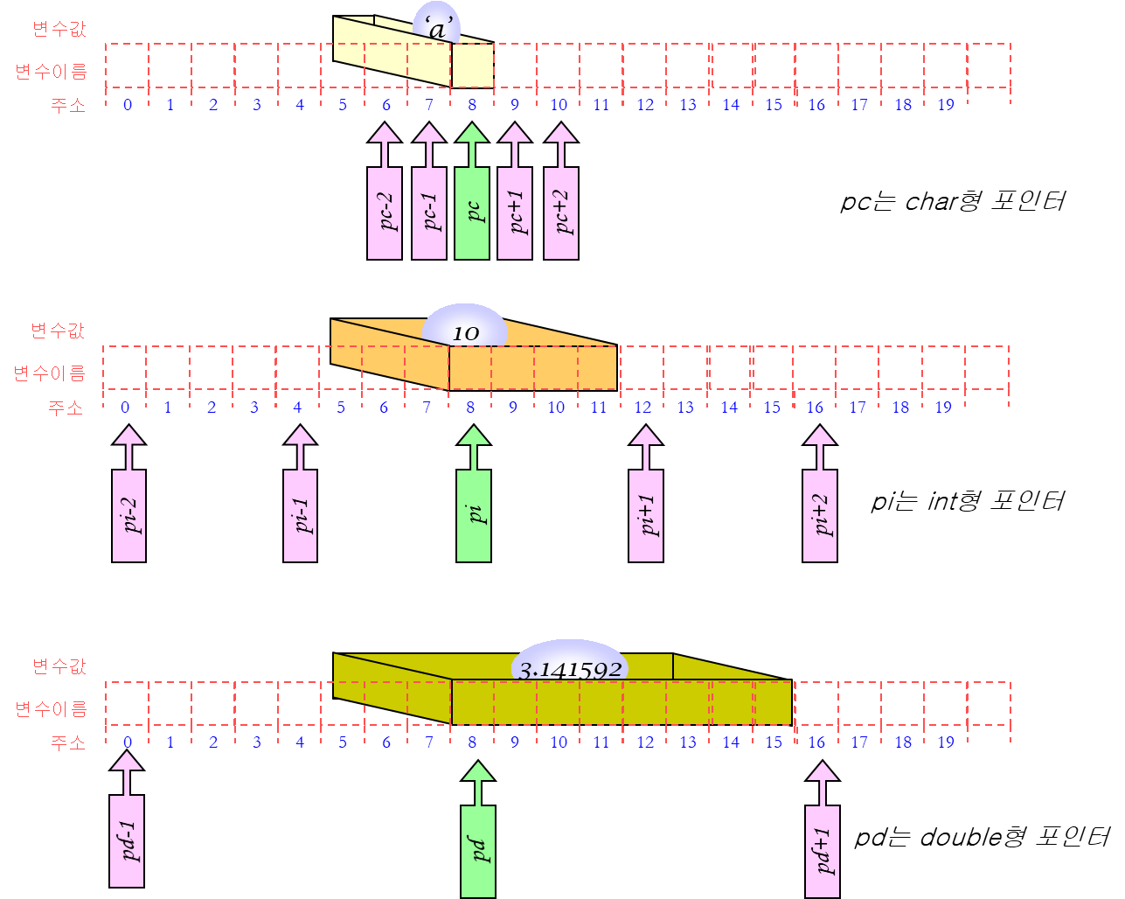
Increment and decrement operations of pointers

Slide 28
Indirect reference operator and increment/decrement operator
*p++;
Increments p after getting the value from the location pointed to by p.
(*p)++;
The value at the location pointed to by p It increases .
formula | meaning
v = *p++ | After assigning the value pointed to by p to v , increment p.
v = (*p)++ | the value pointed to by p to v, increment the value pointed to.
v = *++p | After incrementing p, assign the value pointed to by p to v.
v = ++*p | p increment that value and assign it to v.

Slide 29
Indirect reference operator and increment/decrement operator
// Increment/decrement operation of pointer
#include < stdio.h >
int main( void )
{
int i = 10;
int *pi = & i ;
printf ( " i = %d, pi = %p\n" , i , pi);
(*pi)++;
printf ( " i = %d, pi = %p\n" , i , pi);
*pi++;
printf ( " i = %d, pi = %p\n" , i , pi);
return 0;
}
Increments the value at the location pointed to pi.
After getting the value from the location pointed to by pi, increment pi.
i = 10, pi = 000000FFEBCFF974
i = 11, pi = 000000FFEBCFF974
i = 11, pi = 000000FFEBCFF978

Slide 30
Type conversion of pointers
C language , you can explicitly change the type of a pointer when absolutely necessary .
double * pd = &f;
int * pi;
pi = ( int *)pd;

Slide 31
Example
#include < stdio.h >
int main( void )
{
int data = 0x0A0B0C0D;
char *pc;
int i ;
pc = ( char *)&data;
for (i = 0; i < 4; i++)
printf ( "*(pc + %d) = %02X \n" , i , *(pc + i ));
return 0;
}
*(pc + 0) = 0D
*(pc + 1) = 0C
*(pc + 2) = 0B
*(pc + 3) = 0A

Slide 32
reference
You can feel the danger of pointers a little bit in the increment and decrement operations of pointers . We can increment and decrement pointers as we please, but the incremented pointer may point to the wrong location .
It may refer to other people's data, not data we created, or it may refer to a data area used by the operating system.
In this case, writing or reading a value using a pointer can cause a serious error.

Slide 33

Check points
What operations can be applied to pointers ?
the int pointer p points to address 80 , what address does (p+1) point to ?
p is a pointer, what is the difference between * p++ and (*p)++ ?
If p is a pointer, what does * (p+3) mean ?

Slide 34
How to transfer acquisition
Function How to pass arguments when calling
Call by value (call) by value)
Copy as a function It is delivered.
Basic methods in C.
Call by reference
The original is passed to the function.
In C, this can be emulated using pointers.

Slide 35
swap() function #1 ( call by value )
#include < stdio.h >
void swap( int x, int y);
int main( void )
{
int a = 100, b = 200;
printf(“a=%db=%d\n”,a, b);
swap(a, b);
printf(“a=%db=%d\n”,a, b);
return 0;
}
void swap( int x, int y)
{
int tmp ;
printf(“x=%dy=%d\n”,x, y);
tmp = x;
x = y;
y = tmp ;
printf(“x=%dy=%d\n”,x, y);
}
a=100 b=200
x=100 y=200
x=200 y=100
a=100 b=200

Slide 36
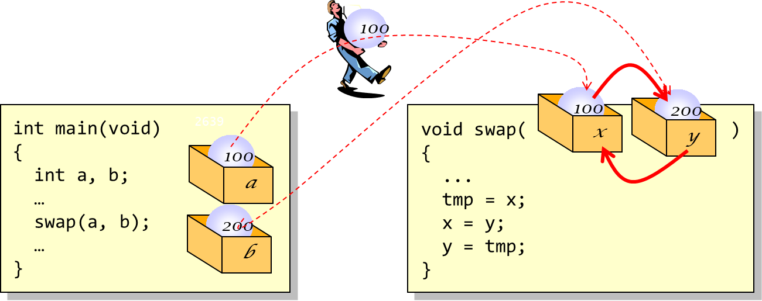
Call by value

Slide 37
swap() function #2 ( call by reference )
#include < stdio.h >
void swap( int x, int y);
int main( void )
{
int a = 100, b = 200;
printf(“a=%db=%d\n”,a, b);
swap(&a, &b);
printf(“a=%db=%d\n”,a, b);
return 0;
}
void swap( int * px , int * py )
{
int tmp ;
tmp = * px ;
* px = * py ;
* py = tmp ;
}
a=100 b=200
a=200 b=100

Slide 38
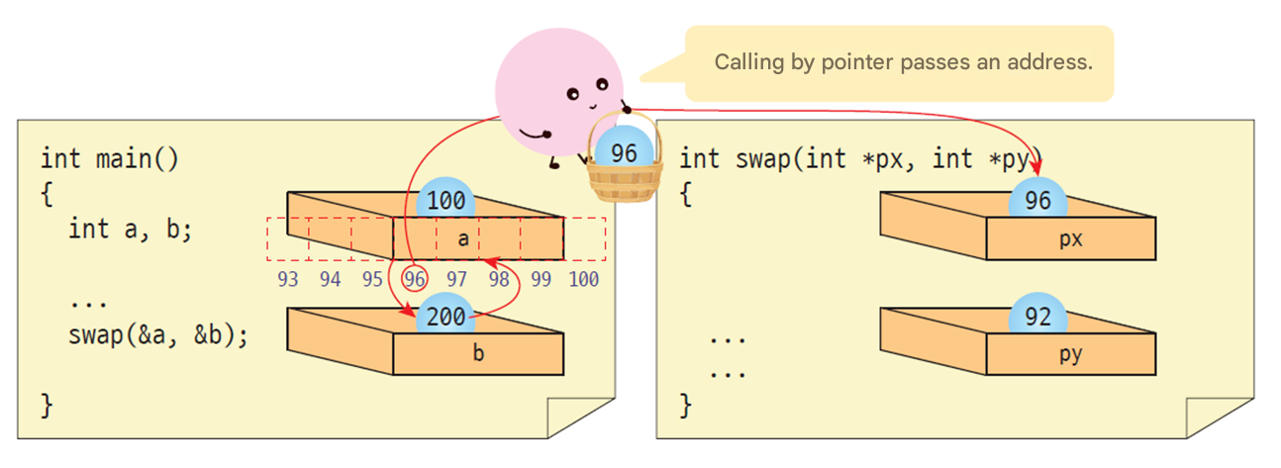
Call by reference

Slide 39
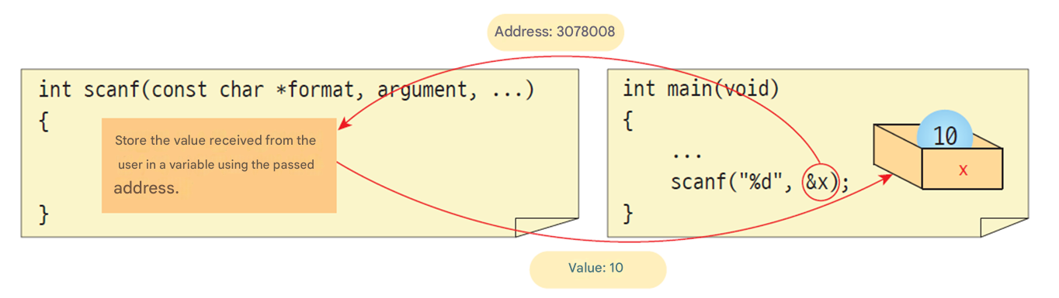
scanf () function
In variables Receives the address of a variable to store a value.

Slide 40
Note : How to prevent a function from changing a value through a pointer ?
When declaring a function parameter, you can do so by adding const in front. Adding const in front means that the content pointed to pointer is a constant that cannot be changed.
void sub( const int *p)
{
*p = 0; // error !!
}

Slide 41
Example
If a function needs to return more than one value, one way to do this is to use pointers . Let's write a function that returns both the slope and the y- intercept of a line .
The slope is 1.000000, and the y- intercept is 0.000000

Slide 42
Return more than two results
#include < stdio.h >
// Slope and Calculate the y-intercept
int get_line_parameter ( int x1, int y1, int x2, int y2, float *slope, float * yintercept )
{
if ( x1 == x2 )
return -1;
else {
*slope = ( float )(y2 - y1)/( float )(x2 - x1);
* yintercept = y1 - (*slope)*x1;
return 0;
}
}
int main( void )
{
float s, y;
if ( get_line_parameter (3,3,6,6,&s,&y) == -1 )
printf ( " Error \n" );
else
printf ( " slope is %f, y-intercept is %f\n" , s, y);
return 0;
}
slope and Y- intercept as arguments
The slope is 1.000000, and the y- intercept is 0.000000

Slide 43
Cautions when returning a pointer
The address of the variable that remains even after the function ends must be returned .
If you return the address of a local variable , it will disappear when the function ends, so it is an error.
int *add( int x, int y)
{
int result;
result = x + y;
return &result;
}
Local variables disappear when the function call ends, so you should not return the address of a local variable .

Slide 44
Pointers and Arrays
Arrays and pointers have a very close relationship .
The array name is actually a pointer .
Pointers can be used like arrays .
a
arrangement
[0]
[1]
[2]
[3]
[4]
[5]
[6]
[7]
[8]
arrangement
Pointer
p
Pointer

Slide 45
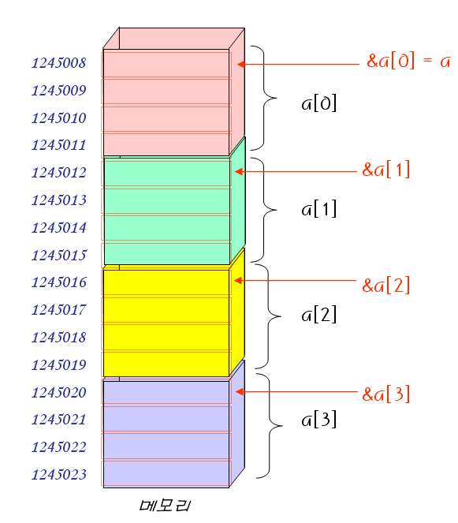
Pointers and Arrays
// Pointer and Array of relationship
#include < stdio.h >
int main( void )
{
int a[] = { 10, 20, 30, 40, 50 };
printf ( "&a[0] = %u\n" , &a[0]);
printf ( "&a[1] = %u\n" , &a[1]);
printf ( "&a[2] = %u\n" , &a[2]);
printf ( "a = %u\n" , a);
return 0;
}
&a[0] = 1245008
&a[1] = 1245012
&a[2] = 1245016
a = 1245008

Slide 46
Example
// Relationship between pointers and arrays
#include < stdio.h >
int main( void )
{
int a[] = { 10, 20, 30, 40, 50 };
printf( "a = %u\n" , a);
printf( "a + 1 = %u\n" , a + 1);
printf( "*a = %d\n" , *a);
printf( "*(a+1) = %d\n" , *(a + 1));
return 0;
}
a = 1245008
a + 1 = 1245012
*a = 10
*(a+1) = 20

Slide 47
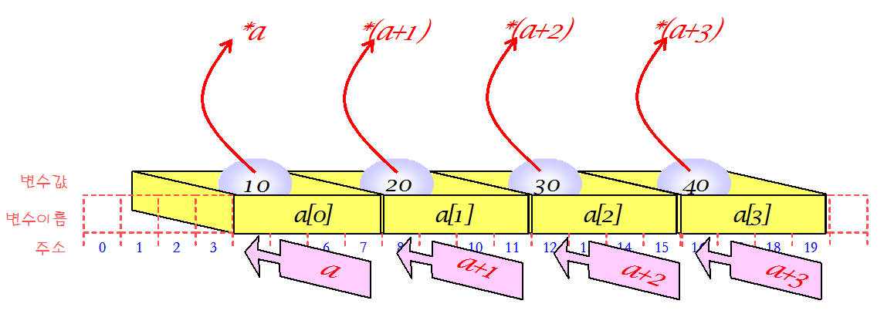
Pointers and Arrays
Pointers can be used like arrays .
Index notation can be used with pointers .

Slide 48
Using pointers like arrays
#include < stdio.h >
int main( void )
{
int a[] = { 10, 20, 30, 40, 50 };
int *p;
p = a;
printf ( "a[0]=%da[1]=%da[2]=%d \n" , a[0], a[1], a[2]);
printf ( "p[0]=%dp[1]=%dp[2]=%d \n\n" , p[0], p[1], p[2]);
p[0] = 60;
p[1] = 70;
p[2] = 80;
printf ( "a[0]=%da[1]=%da[2]=%d \n" , a[0], a[1], a[2]);
printf ( "p[0]=%dp[1]=%dp[2]=%d \n" , p[0], p[1], p[2]);
return 0;
}
You can see that arrays are ultimately implemented as pointers .
Array elements can be changed through pointers.
a[0]=10 a[1]=20 a[2]=30
p[0]=10 p[1]=20 p[2]=30
a[0]=60 a[1]=70 a[2]=80
p[0]=60 p[1]=70 p[2]=80

Slide 49
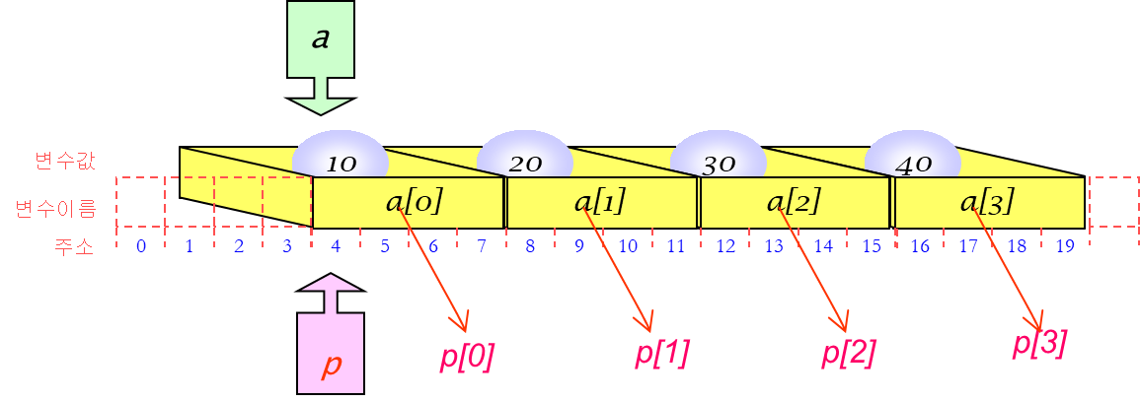
A pointer can also be used as an array name.

Slide 50
Array parameters
General parameters vs Array parameters
Why? -> Copying an array to a function is time-consuming, so only pass the address of the array .
// Assign parameters variable x at memory place
void sub( int x)
{
...
}
// b does not have memory allocated to it
void sub( int b[] )
{
...
}

Slide 51
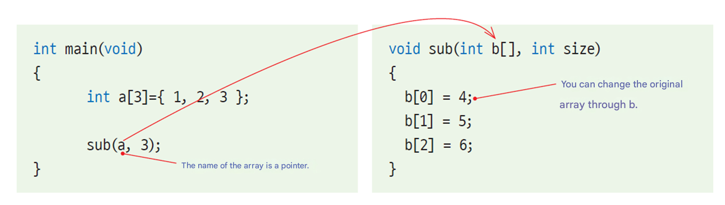
Array parameters
Array parameters can be thought of as pointers .

Slide 52
// Relationship between pointers and functions
#include < stdio.h >
void sub( int b [], int n );
int main( void )
{
int a[3] = { 1,2,3 };
printf( "%d %d %d\n" , a[0], a[1], a[2]);
sub(a, 3);
printf( "%d %d %d\n" , a[0], a[1], a[2]);
return 0;
}
void sub( int b [], int n )
{
b [0] = 4;
b [1] = 5;
b [2] = 6;
}
1 2 3
4 5 6

Slide 53
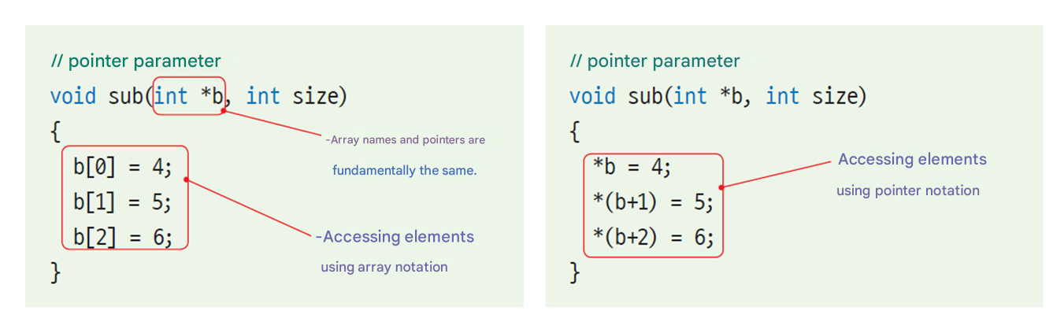
The following two methods are completely equivalent :

Slide 54
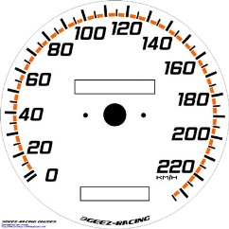
Advantages of using pointers
When the compiler optimizes, the performance becomes almost similar .
Pointers are faster than index notation .
Why?: There is no need to convert index to address .
int get_sum1( int a[], int n)
{
int i ;
int sum = 0;
for ( i = 0; i < n; i ++ )
sum += a[ i ];
return sum;
}
int get_sum2( int a[], int n)
{
int i , sum =0 ;
int *p;
p = a;
for ( i = 0; i < n; i ++ )
sum += *p++;
return sum;
}
Using index notation
Using pointers

Slide 55
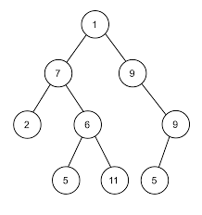
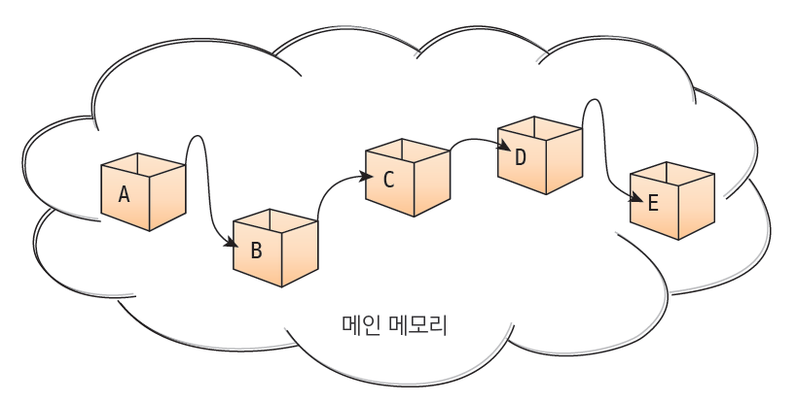
Advantages of using pointers
You can create advanced data structures such as linked lists and binary trees .
Call by reference
You can change the value of a variable outside the function by using a pointer as a parameter .

Slide 56
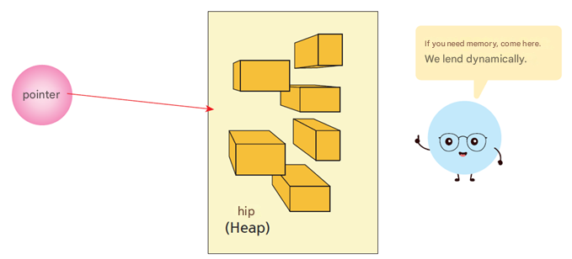
Advantages of using pointers
Memory mapping hardware
Memory-mapped hardware refers to hardware devices that can be accessed like memory .
Dynamic memory allocation
Covered in Chapter 17 .
To use dynamic memory, you must have a pointer .
volatile int * hw_address = (volatile int *)0x7FFF;
* hw_address = 0x0001; // Write value 0x0001 to the device at address 0x7FFF .

Slide 57
Q & A

